Slide 1

Programming Laboratory – V (SPOS) 18BTIS511 Assignment 2
Implement pass-II of a two-pass assembler. The output of assignment-1 (intermediate file, symbol and literal table) should be input for this assignment.
Prepared By – Dr. Jyoti Malhotra
Prof. Pranav More

Slide 2
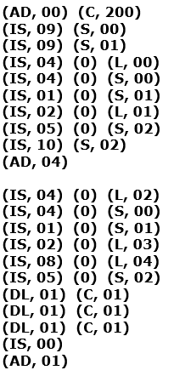
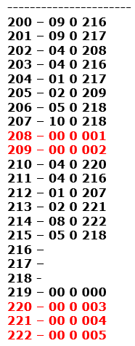
INPUT
OUTPUT

Slide 3
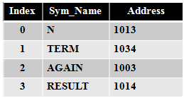
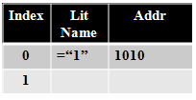
(AD, 00) (C, 1000)
(IS, 09) (S, 00)
(IS, 04) (1) (L, 00)
(IS, 05) (1) (S, 01)
(IS, 03) (1) (S, 01)
(IS, 04) (2) (S, 01)
(IS, 01) (2) (L, 00)
(IS, 05) (2) (S, 01)
(IS, 06) (2) (S, 00)
(IS, 07) (1) (S, 02)
(IS, 05) (1) (S, 03)
(AD, 04)
(IS, 10) (S, 03)
(IS, 00)
(DL, 01) (C, 1)
(DL, 01) (C, 20)
(DL, 01) (C, 1)
(AD, 01)
TARGET CODE -
1000) 09 0 1013
1001) 04 1 1010
1002) 05 1 1034
1003) 03 1 1034
1004) 04 2 1034
1005) 01 2 1010
1006) 05 2 1034
1007) 06 2 1013
1008) 07 1 1003
1009) 05 1 1014
1010) 00 0 0001
1011) 10 0 1014
1012) 00 0 0000
1013)
1014)
1034)
1035)
No register operand present
From (S, 00) I.e.
S[0].Address i.e. 1013
Internal representation of =‘1’ (no opcode and register code)

Slide 4
2-pass assembler practice example 4
Write Target code for following IC of TWO Pass assembler with hypothetical Instruction set. (Assume symbols, literal, symbol table and literal table)
(AD, 00) (C, 200)
(IS, 09) (S, 00)
(IS, 09) (S, 01)
(IS, 04) (0) (L, 00)
(IS, 04) (0) (S, 00)
(IS, 01) (0) (S, 01)
(IS, 02) (0) (L, 01)
(IS, 05) (0) (S, 02)
(IS, 10) (S, 02)
(AD, 04)
(IS, 04) (0) (L, 02)
(IS, 04) (0) (S, 00)
(IS, 01) (0) (S, 01)
(IS, 02) (0) (L, 03)
(IS, 08) (0) (L, 04)
(IS, 05) (0) (S, 02)
(DL, 01) (C, 01)
(DL, 01) (C, 01)
(DL, 01) (C, 01)
(IS, 00)
(AD, 01)
Assumption – 3 symbols are A,B, C and 5 literals are 1,2,3,4,5
Based on this assumption; following are the required data structures:
(AD, 04) signifies IC for LTORG i.e. End of the previous pool
(AD, 01) signifies IC for END i.e. end of the program and existing pool
Tasks:
Create constant representation for literals of previous pool by incrementing LC value.
(S, 00) and (L,00) meaning S[0].address and L[0].address-
Create suitable data structures and write target code.

Slide 5
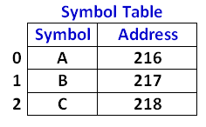
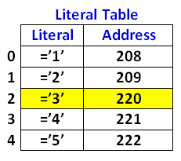
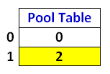
2-pass assembler practice example 4
Write Target code for following IC of TWO Pass assembler with hypothetical Instruction set. (Assume symbols, literal, symbol table and literal table)
(AD, 00) (C, 200)
(IS, 09) (S, 00)
(IS, 09) (S, 01)
(IS, 04) (0) (L, 00)
(IS, 04) (0) (S, 00)
(IS, 01) (0) (S, 01)
(IS, 02) (0) (L, 01)
(IS, 05) (0) (S, 02)
(IS, 10) (S, 02)
(AD, 04)
(IS, 04) (0) (L, 02)
(IS, 04) (0) (S, 00)
(IS, 01) (0) (S, 01)
(IS, 02) (0) (L, 03)
(IS, 08) (0) (L, 04)
(IS, 05) (0) (S, 02)
(DL, 01) (C, 01)
(DL, 01) (C, 01)
(DL, 01) (C, 01)
(IS, 00)
(AD, 01)
Assumption – 3 symbols are A,B, C and 5 literals are 1,2,3,4,5
Based on this assumption; following are the required data structures:

Slide 6
Input
(AD, 00) (C, 200)
(IS, 09) (S, 00)
(IS, 09) (S, 01)
(IS, 04) (0) (L, 00)
(IS, 04) (0) (S, 00)
(IS, 01) (0) (S, 01)
(IS, 02) (0) (L, 01)
(IS, 05) (0) (S, 02)
(IS, 10) (S, 02)
(AD, 04)
(IS, 04) (0) (L, 02)
(IS, 04) (0) (S, 00)
(IS, 01) (0) (S, 01)
(IS, 02) (0) (L, 03)
(IS, 08) (0) (L, 04)
(IS, 05) (0) (S, 02)
(DL, 01) (C, 01)
(DL, 01) (C, 01)
(DL, 01) (C, 01)
(IS, 00)
(AD, 01)
----------------------
200 – 09 0 216
201 – 09 0 217
202 – 04 0 208
203 – 04 0 216
204 – 01 0 217
205 – 02 0 209
206 – 05 0 218
207 – 10 0 218
208 – 00 0 001
209 – 00 0 002
210 – 04 0 220
211 – 04 0 216
212 – 01 0 207
213 – 02 0 221
214 – 08 0 222
215 – 05 0 218
216 –
217 –
218 -
219 – 00 0 000
220 – 00 0 003
221 – 00 0 004
222 – 00 0 005
Output

Slide 7
INPUT
Tokens Possibilities :
Tokens : 2, 4 and 5
(AD, 00) (C, 200)
Tok1
Tok2
Tok3
Tok4
2 Tokens:
(AD, 00)
(AD, 01)
(AD, 02)
(AD, 03)
(AD, 04) - START to LTORG
(IS, 00) - IMPERATIVE STATMENT
4 Tokens:
(AD, 00) (C,200) - START / ORIGIN
(IS, 09) (S, 01) - IMPERATIVE STATMENT
(IS, 10) (S, 01)
(DL, 00) (C, 04) – DECLARATIVE STATEMENT
(DC, 01) (C, 01)
5 Tokens:
(IS, 06) (2) (S, 01) - IMPERATIVE STATMENT

Slide 8
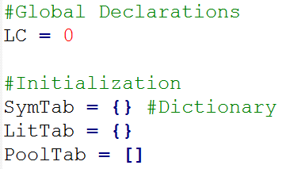
Program template
########## Main program starts here #######
generateDatastructures() #Generate Symbol, Literal, and Pool table
fp1 = open("IC.txt","r") # Intermediate code file
fp2 = open("output.txt","w") # Output target file
for line in fp1:
tokens = line.split(" ") #Tokenize the instruction
tokCnt = len(tokens) #Gives token length
if tokCnt == 2:
processTok2(tokens)
elif tokCnt == 4:
processTok4(tokens)
elif tokCnt ==5: #ADD-DIV, DS/DC, EQU
processTok5(tokens)
LC=LC+1
######End for ####
fp1.close()
fp2.close()
Initialization

Slide 9
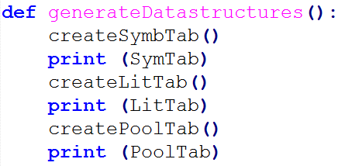
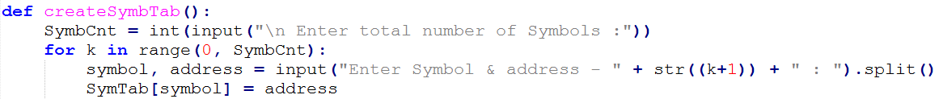
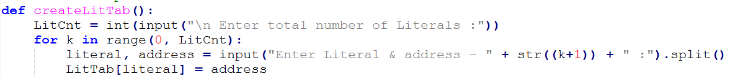
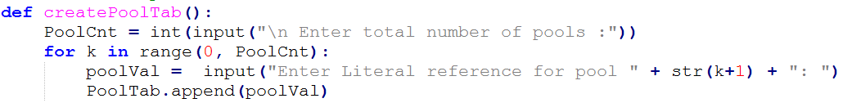
Generate Data structures

Slide 10
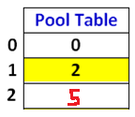
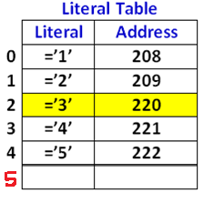
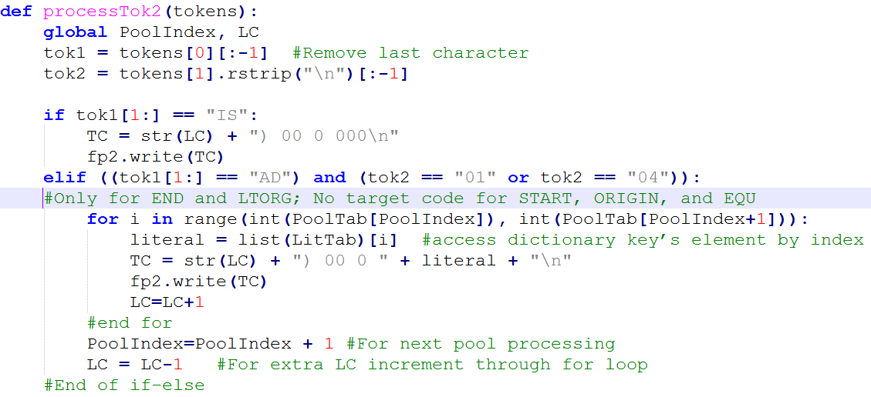
For the given example; there are 3 pools, and third pool is empty.
for i in range(0,2) for first pool
for i in range(2,5) for second pool
(REFER PoolTable)

Slide 11
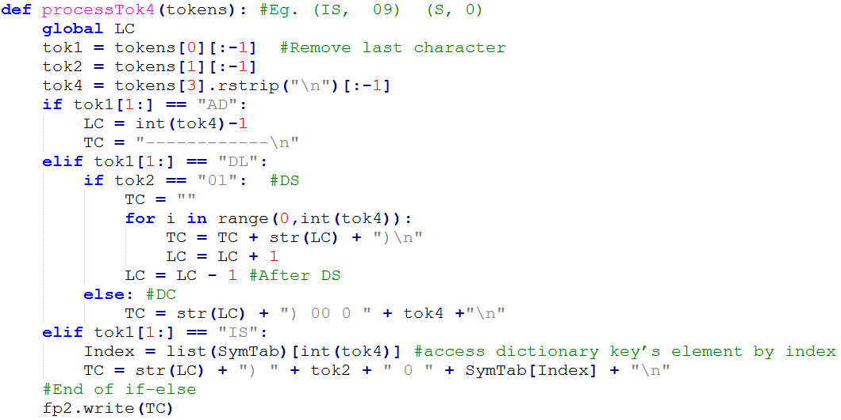

Slide 12
